Slide 1
CSE7000 - INTERNSHIP A Presentation on MACHINE LEARNING INTERNSHIP
Student Details
Name | Sanika H Y
Roll No | 20241CSE0950
Section | 5CSE14
Under the Supervision of,
Mr. Sakthi S
Assistant Professor
Presidency School of Computer Science and Engineering
Presidency University
Name of the Program: Computer Science and Engineering
Name of the HoD: Dr.Asif Mohammed H.B
Name of the Program Internship Coordinator: Dr.Balakrishnan Raju
Name of the School Internship Coordinators: Dr. Bhuvaneshwari Patil

Slide 2
Content
About Company or Organization
Working domain or the Technology
Objectives of the work
Methodology Used / Course Description
Results
Conclusion

Slide 3
About Company or Organization
InternSpark:
InternSpark is an online internship and training platform.
It provides industry-oriented internships and live projects.
The platform helps students develop practical technical skills.
It aims to bridge the gap between academic learning and industry requirements.

Slide 4
Products & Services
Developed basic Machine Learning prediction models.
Performed data cleaning and preprocessing.
Built Iris Flower Classification and Titanic Survival Prediction models.
Built a House Price Prediction model using Machine Learning.
Target Clients
Students and educational institutions.
Startups and small businesses.
Companies interested in basic data analysis.
Organizations looking to explore Machine Learning solutions.

Slide 5
Working domain or the technology
• Domain: Machine Learning (ML)
• Overview: Machine Learning is a technology that enables computers to learn from data and make predictions or decisions without being explicitly programmed.
Features: • Data preprocessing and analysis • Predictive modelling • Classification and regression
Importance: • Helps in making data-driven predictions • Improves efficiency and accuracy • Provides practical solutions to real-world problems

Slide 6
Tools & Technologies Used:
• Python • Pandas • NumPy • Scikit-learn • Jupyter Notebook

Slide 7
Objectives of the work
Purpose:
• To develop basic Machine Learning models for prediction and analysis. • To gain practical knowledge of data preprocessing, model training, and evaluation.
Usage:
• Used to predict outcomes from given datasets. • Helps identify useful patterns and relationships in data. • Can be applied to solve various real-world prediction and classification problems.

Slide 8
Methodology Used / Course Description
Methodology
• Data Collection – Collected and understood the datasets used for the ML projects. • Data Preprocessing – Cleaned the data and handled missing or unnecessary values. • Exploratory Data Analysis (EDA) – Analyzed the datasets to identify patterns and relationships. • Feature Selection – Selected relevant features required for model building. • Model Training – Trained suitable Machine Learning models using Scikit-learn. • Model Evaluation – Evaluated the models using appropriate performance metrics. • Prediction & Results – Generated predictions and analyzed the final results.

Slide 9
Course Description
• Introduction to Machine Learning concepts and applications • Python programming for data analysis and ML • Data preprocessing, cleaning, and visualization • Supervised learning techniques for classification and regression • Machine Learning model development and testing • Model evaluation and interpretation of results

Slide 10
Results
• Successfully completed the 2-month Machine Learning internship at Internspark. • Developed and tested Machine Learning models using real-world datasets. • Gained hands-on experience in data preprocessing, analysis, and model evaluation. • Improved Python programming, analytical thinking, and problem-solving skills. • Successfully completed projects on Iris Flower Classification, Titanic Survival Prediction, and House Price Prediction.

Slide 11
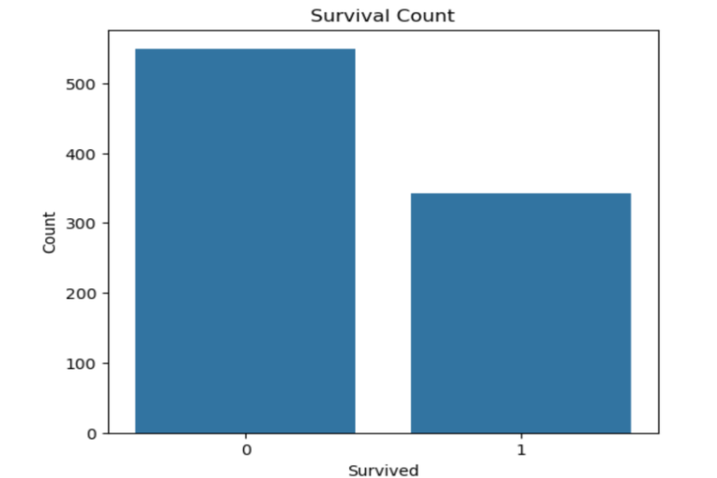
Results
Figure 1.1 shows the predicted survival outcomes obtained from the Titanic Survival Prediction project. The model analysed passenger information and predicted whether each passenger survived or did not survive. The figure provides a visual representation of the prediction results and demonstrates how the trained classification model was used to solve the survival prediction problem.
Fig 1.1 Titanic survival graph

Slide 12
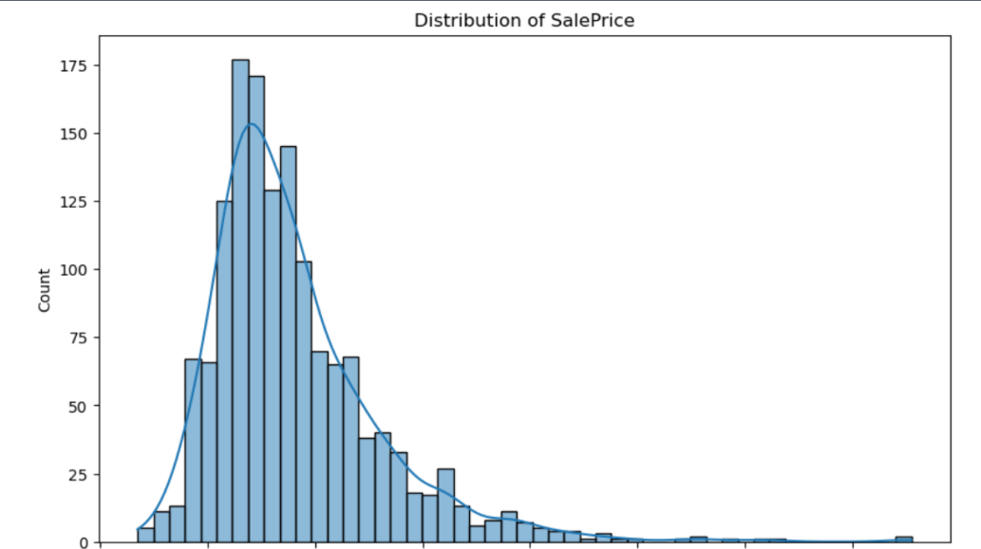
Figure 1.2 shows the predicted house prices obtained from the House Price Prediction project. The model used different property features to estimate the price of each house. The figure represents the output generated by the trained regression model and demonstrates how Machine Learning can be used to predict continuous numerical values such as house prices
Fig 1.2 House Price Prediction

Slide 13
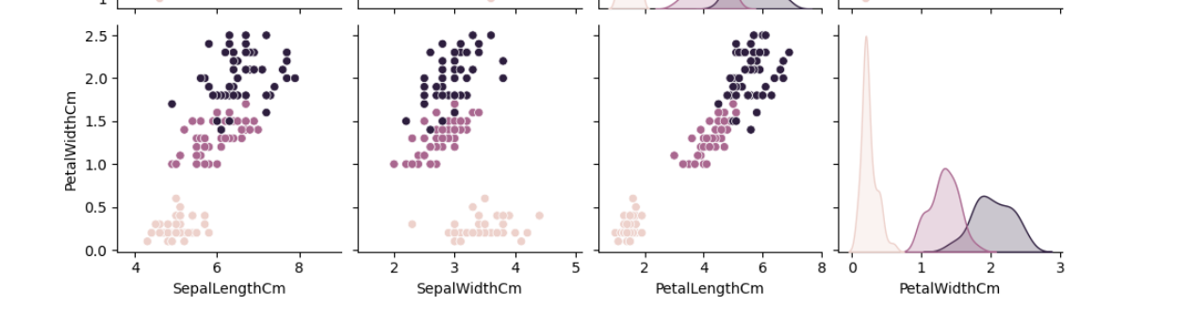
Figure 1.3 shows the classification results obtained from the Iris Flower Classification project. The model used sepal and petal measurements to identify the species of each iris flower. The figure represents the classification results and demonstrates how the trained model can distinguish between different flower species based on their features.
Fig 1.3 Iris flower classification graph

Slide 14
Conclusion
• Successfully completed the Machine Learning internship. • Gained practical knowledge of ML and Python. • Improved data analysis and model-building skills. • Enhanced problem-solving and technical skills. • Completed three ML projects successfully. • Prepared for future projects and career opportunities.

Slide 15
Q&A

Slide 16
Thank you !!

